Slide 1
RSGAN
pre-condition (sentence descriptions)
Generated video

Slide 2
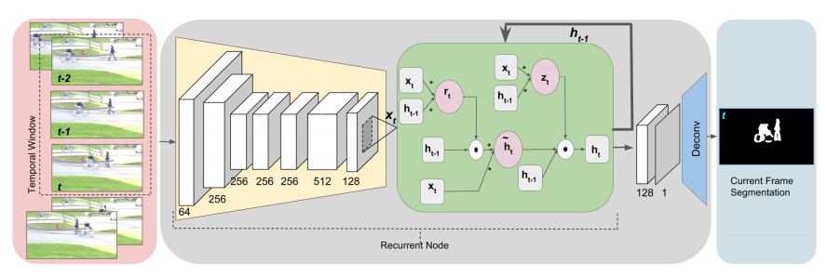
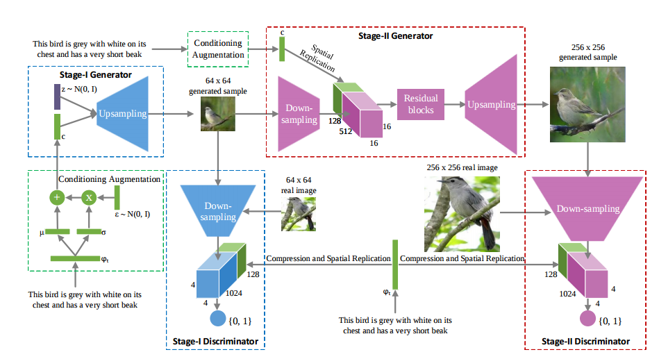

Slide 3
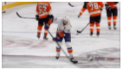
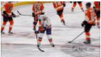
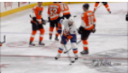
⋯
⋯
⋯
⋯
⋯
⋯
256 × 256
256 × 256
256 × 256
Stage 2
RSGAN-2
RSGAN-2
RSGAN-2
The men are playing ice-hockey
(pre-condition)
64 × 64
64 × 64
64 × 64
Stage 1
RSGAN-1
RSGAN-1
RSGAN-1
Z₁
Z₂
Z₃

Slide 4
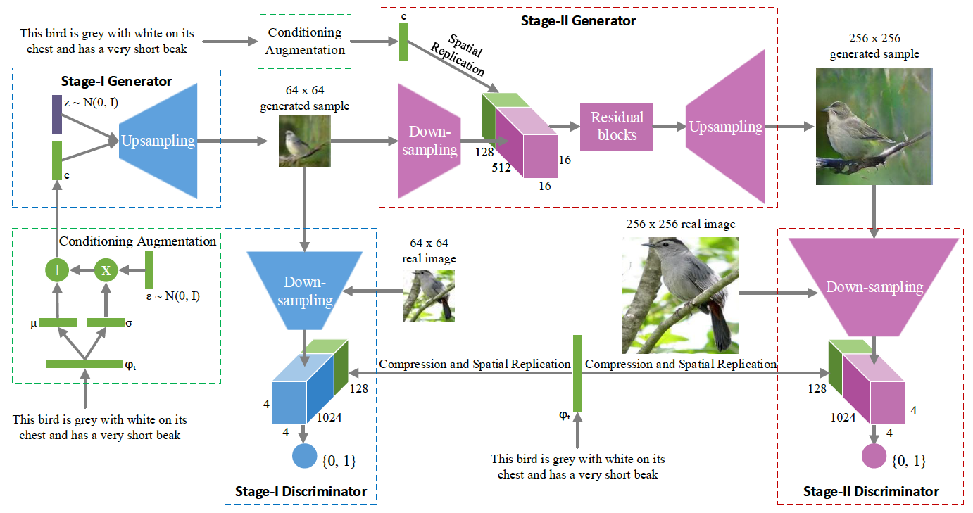
⋯
⋯
⋯
⋯
⋯
⋯
256 × 256
256 × 256
256 × 256
Stage 2
RSGAN-2
RSGAN-2
RSGAN-2
The men are playing ice-hockey
(pre-condition)
64 × 64
64 × 64
64 × 64
Stage 1
RSGAN-1
RSGAN-1
RSGAN-1
Z₁
Z₂
Z₃

Slide 5
⋯
⋯
⋯
⋯
⋯
⋯
256 × 256
256 × 256
256 × 256
Stage 2
RSGAN-2
RSGAN-2
RSGAN-2
The men are playing ice-hockey
(pre-condition)
64 × 64
64 × 64
64 × 64
Stage 1
RSGAN-1
RSGAN-1
RSGAN-1
Z₁
Z₂
Z₃

